Slide 1
Introduction to OOP
Arif Istiake Sunny Senior AI Engineer Brain Station 23 PLC
Mobile: 01732009493
Email: sunny1509006@gmail.com

Slide 2
Contents
Object Oriented Programing (OOP)
Classes Objects
Introducing Method
Default Constructors Parameterized Constructor
Pass Statement Intro to Inheritance

Slide 3
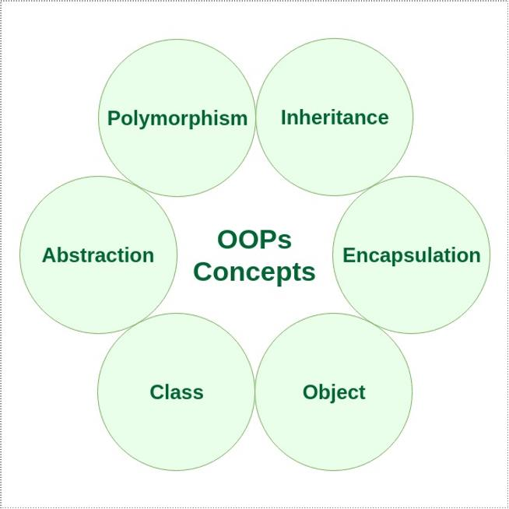
Object Oriented Programming (OOP)
Object-oriented programming (OOP) is a computer programming model that organizes software design around data, or objects, rather than functions and logic. An object can be defined as a data field that has unique attributes and behavior.

Slide 4
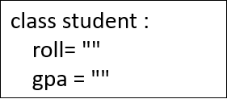
Classes
Classes are user-defined data types that act as the blueprint for individual objects, attributes and methods
An example of a class is the class Student. Students usually have a roll and gpa; these are
attributes.

Slide 5
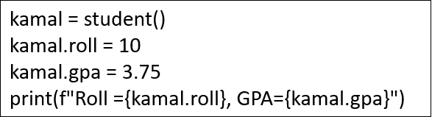
Objects
An Object is an instance of a Class. A class is like a blueprint while an instance is a copy of the class with actual values.

Slide 6
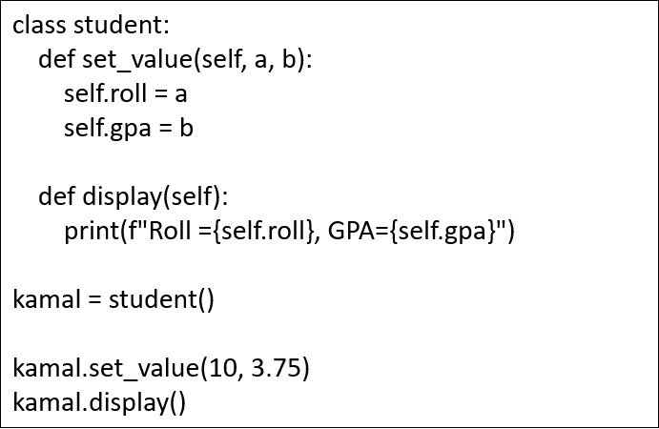
Introducing Method
A method is a function that “belongs to” an object.

Slide 7
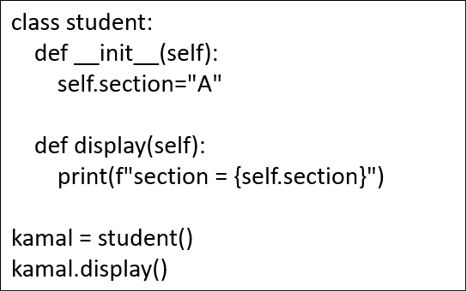
Default Constructors
Constructors are generally used for instantiating an object

Slide 8
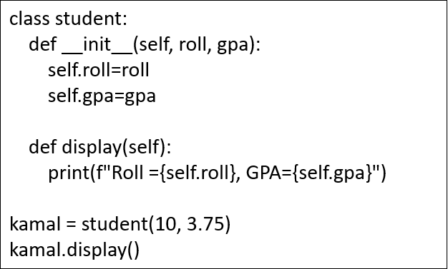
Parameterized Constructors
Constructors are generally used for instantiating an object

Slide 9


Pass Statement
Create a placeholder for future code:

Slide 10


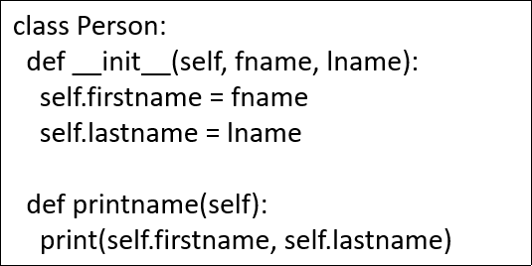
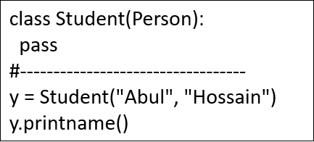
Intro to Inheritance
Inheritance allows us to define a class that inherits all the methods and properties from another class.
Parent class is the class being inherited from, also called base class.
Child class is the class that inherits from another class, also called derived class.

Slide 11

Avengers: Age of OOP
After the last battle, Tony Stark realized fighting villains alone wasn’t scalable. So, he did what every genius billionaire would do — started a coding bootcamp for the Avengers called "Pyvengers"

Slide 12
What is Object-Oriented Programming (OOP)?
Tony:
"Avengers, listen up! Object-Oriented Programming is like building your own
superheroes. You define a blueprint — that’s called a class. Then you can make multiple versions of that superhero — those are objects."
Thor (confused):
"Is Mjölnir an object or a class?"
Tony:
"It’s an object, obviously! But if we made many hammers with lightning powers —
that would be a class."

Slide 13

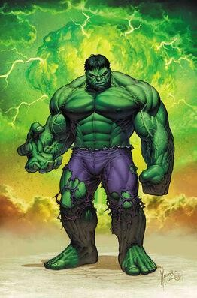
Creating a Class & Object
Tony:
"Let’s create a class named Avenger and then create objects like IronMan, Hulk,
etc."

Slide 14


Introducing Methods
Tony:
"A method is like a superhero’s ability. You attach it to the class, and every object
can use it."
Thor:
"And I shall introduce myself with thunder!"

Slide 15

Default Constructor
Tony:
"When you want to set something by default when an object is created, you use a
constructor."
Steve:
“Avengers... Initialized!”

Slide 16

Parameterized Constructor
Tony:
"But if you want to customize your Avenger while creating them..."
Spider-Man:
"Finally! I’m not just the intern anymore."

Slide 17
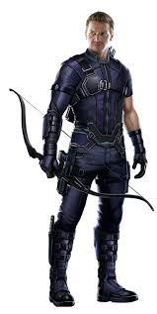
Pass Statement
Tony:
"And sometimes, you just want a placeholder — like Hawkeye in the final battle. You
use pass."
Hawkeye:
"Hey! I was useful... kinda."

Slide 18
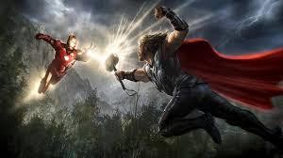
Intro to Inheritance
Tony:
"Now comes the big stuff — inheritance. Suppose all Avengers are heroes. Let’s
build a base class Hero, and let other heroes inherit its powers."
Thor:
"So my powers can be... inherited?"
Tony:
"Well, not the god complex — but yes."

Slide 19

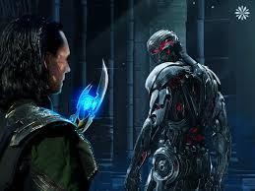
Homework (For Students)
Create a Villain class and inherit from it to create Loki and Ultron.
Add different methods for each villain.
Use constructors to initialize their evil plans.

Slide 20

Closing Line (From Tony)
"Remember team — in OOP, with great classes comes great objects!"

Slide 21
Thank You

